Slide 1

U of T Computer Graphics Club

Slide 2
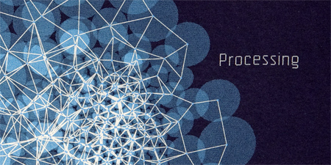
If you haven’t downloaded processing yet
https://www.processing.org/download/

Slide 3
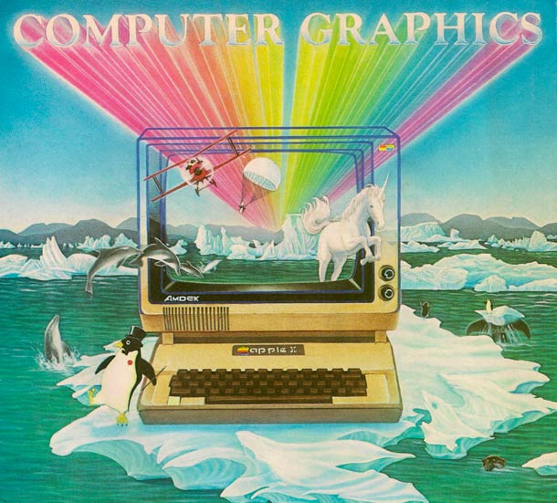

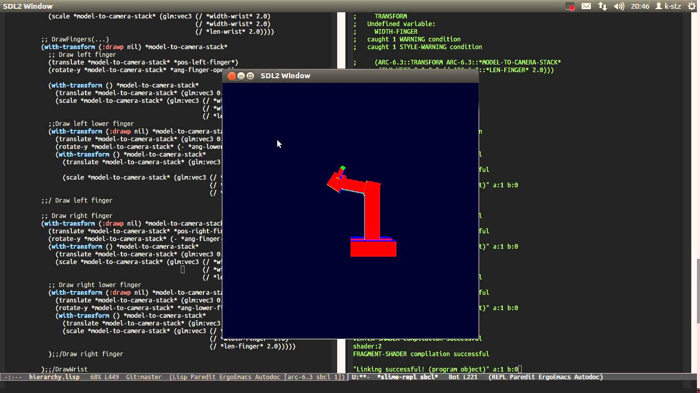
What do we do in this club?

Slide 4
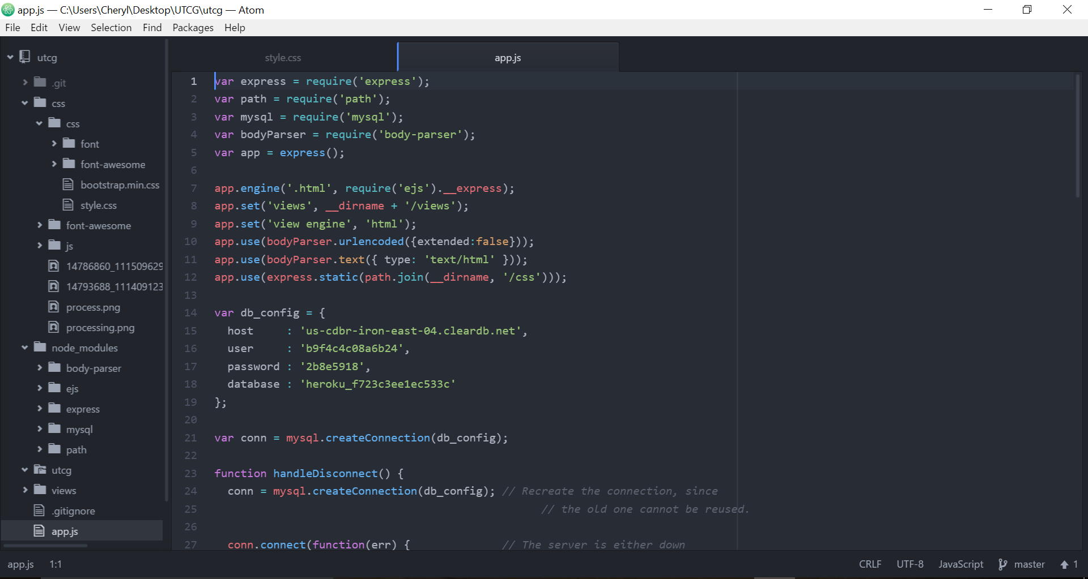
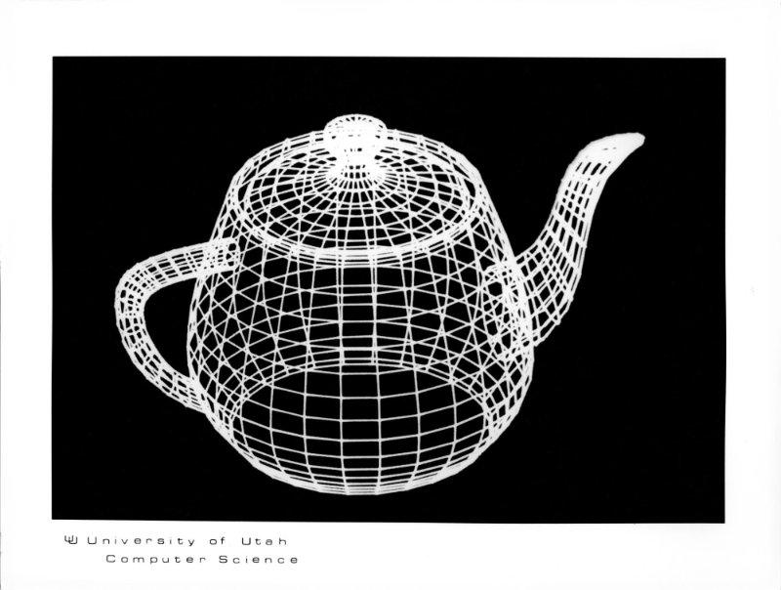
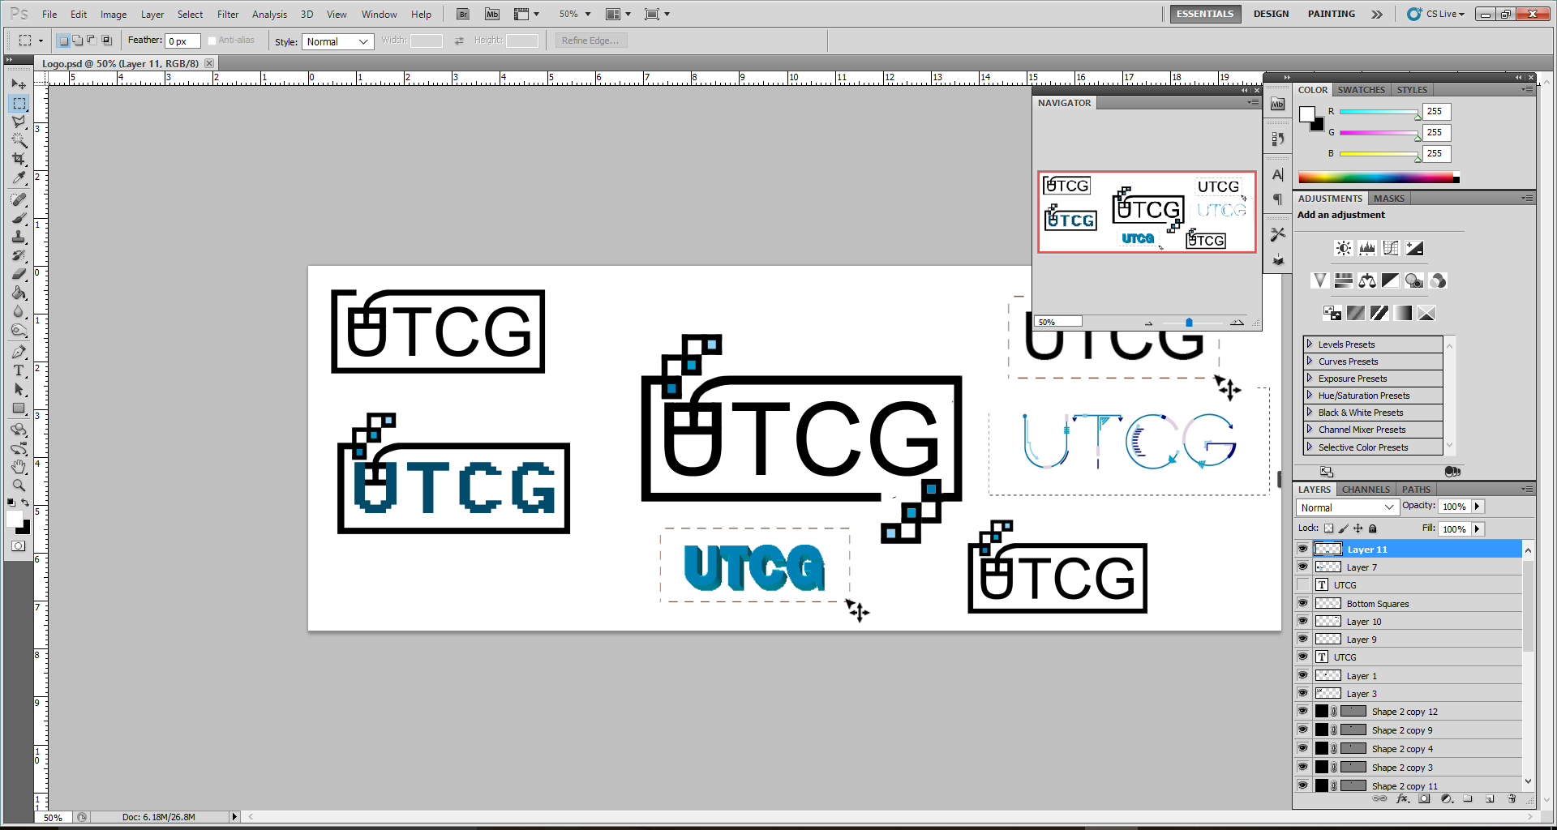
What do we do in this club?
Look at computer graphics from the artistic side and the computer science side
Workshops/Tutorials
Digital Painting
Processing
Web design
3D modelling
Lab tours
Group projects
Paintchat paintathon

Slide 5
How you can get involved
Suggest workshops
Teach a workshop
Apply for a director/coordinator position (more on this later)
Attend workshops
Tell your friends about the club!

Slide 6

FAQ
I don’t know how to program. Can I still join?
YES
I’m bad at art. Can I still join?
YES
I can’t make it to the meetings! What do I do?
We’ll try to find a time that works for most people
I want to teach a workshop! Who do I contact?
utcomputergraphics@gmail.com
What’s the club website?
NOT utcg.org! It’s going to be utcg.sa.utoronto.ca

Slide 7
Any Questions/Concerns/ideas?

Slide 8

An Introduction to Processing
Programming in the context of Visual Arts

Slide 9
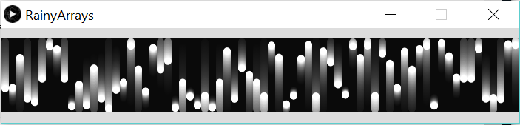
What is Processing?
A programming language that lets you create basic shapes, patterns and animations through coding!

Slide 10
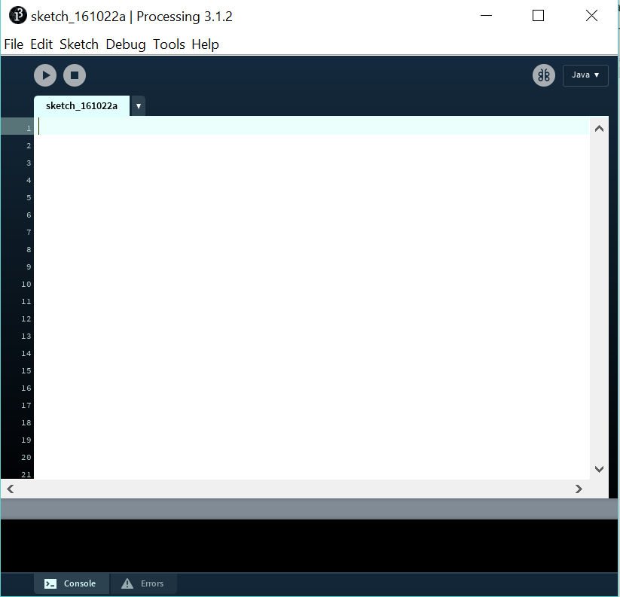
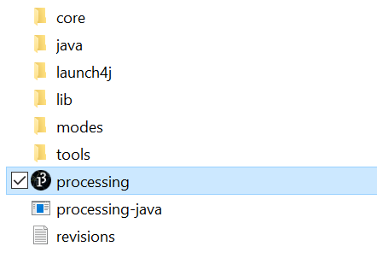
Downloading & Running Processing
https://www.processing.org/download/
Unzip the file, run processing.exe

Slide 11
A bit on Programming terminology
Variable
int - Integers
float - Decimals
int x = 5;
Function
void dostuff(){
ThingsToDo;
}
do_stuff();
Parameter
do_something(with_this_specification);

Slide 12
Watch out!
Capitalisation matters
So ellipse(100, 20, 30, 40); will work but Ellipse(100, 20, 30, 40); will NOT work
Make sure you’re putting your lines of code in the right function!
Put it in setup(){ … } if you only want it to run once in the beginning
Put it in draw(){ … } if you want it to run every frame
Start your line with “//” to make it into a comment (something that isn’t executed when the program is run)
//Comments are helpful!

Slide 13
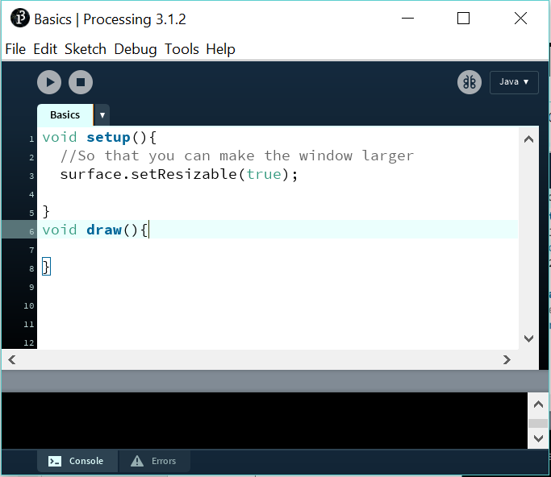
Starting from the basics

Slide 14
Basic shapes:
ellipse(x coord, y coord, width, height);
rect(x cood, y cood, width, height);
The units are pixels
Order matters!
Psst: Other parameters to mess around with:
rect(x cood, y cood, width, height, radii of the 4 corners, tl radius , tr rad, bl rad, br rad);
Try triangle(p1 x coord, p1 y coord, p2 x coord, p2 y coord, p3 x coord, p3 y coord);

Slide 15

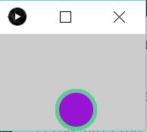
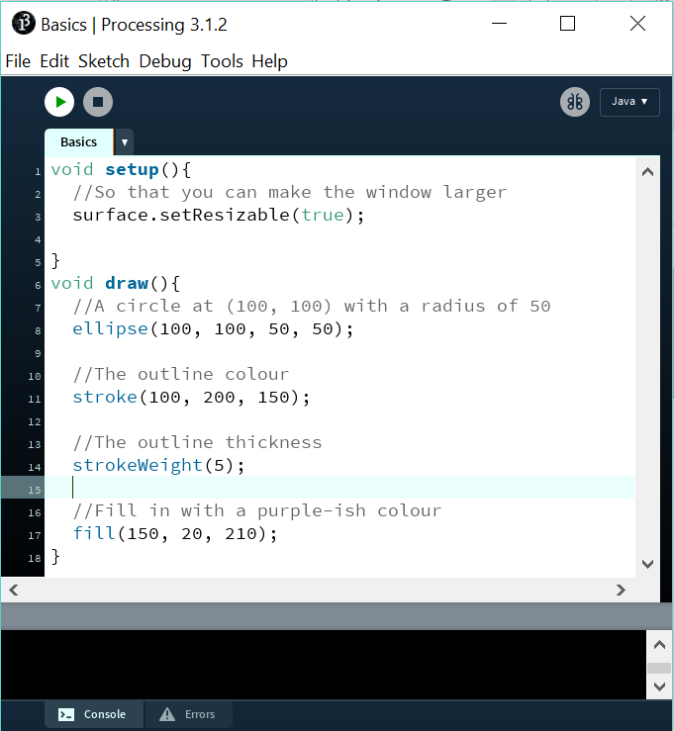
It’s a colourful world
//Setting the outline colour of a shape
stroke(RGB);
//Outline thickness
strokeWeight(stroke_width);
//Fill colour
fill(RGB);

Slide 16
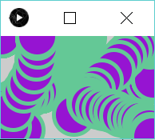
Interactivity, Mon ami!
mouseX and mouseY give you the x and y coordinate of the mouse cursor
Use mouseX and mouseY as your x and y coordinates to make your drawing interactive!

Slide 17
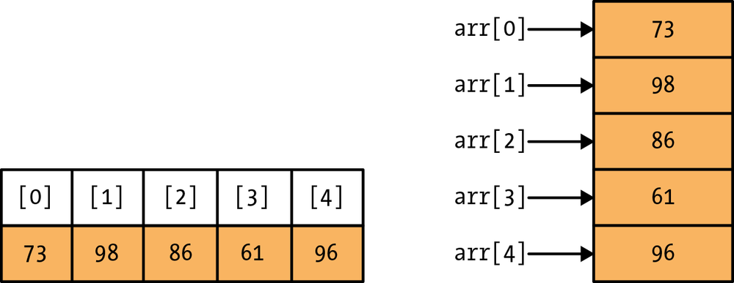
Arrays

Slide 18
Loops
i is the index that you’re increasing
number is the maximum value of i
for (int i = 0; i < number; i++) {
//Stuff in here gets repeated
}

Slide 19
The setup() method
void setup() {
size(100, 100);
noStroke();
fill(255, 102);
}

Slide 20
The draw() method-part 1
//Put this at the very top of your program
//Max radius of your circles
int num = 50;
//Arrays to hold the locations of your circles
int[] x = new int[num];
int[] y = new int[num];

Slide 21
The Draw() method-part 2
//INSIDE the draw() method
//Set background colourto black
background(0);
// Shift the values in the array to the right to make room for the new element
for (int i = num-1; i > 0; i--) {
//Moving the element at index i to index i-1
x[i] = x[i-1];
y[i] = y[i-1];
}

Slide 22
The Draw() method-part 3
// Add the new values to the beginning of the array (Position 0)
x[0] = mouseX;
y[0] = mouseY;
// Draw the circles "num" times in the same spot with increasing radii to make it look like it's growing
for (int i = 0; i < num; i++) {
ellipse(x[i], y[i], i/2.0, i/2.0);
}

Slide 23
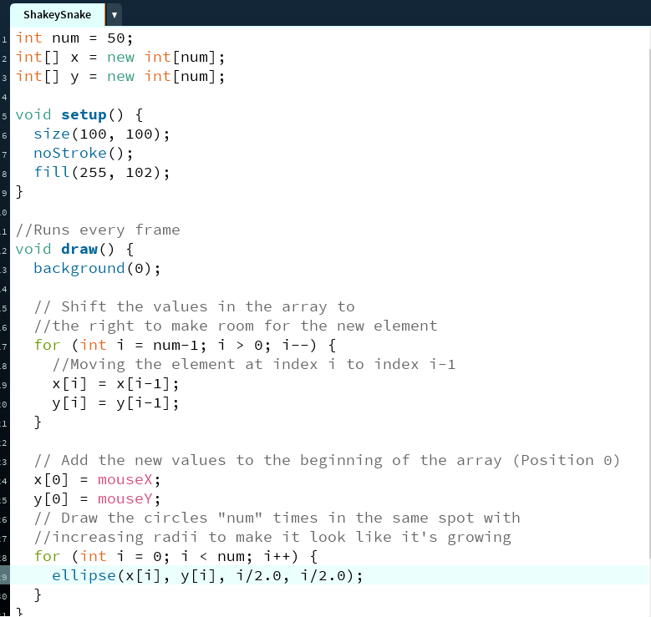

Slide 24
Any last questions/comments?

Slide 25



Thanks for coming!
utcomputergraphics@gmail.com
UTCG University of Toronto Computer Graphics Club
utcg.sa.utoronto.ca

